Slide 1

SANJIVANI UNIVERSITY
SANJIVANI GROUP OF INSTITUTES
Presentation On:
Reinforcement Learning
Presented By:
Kolhe Shamal Navnath
Guided By: HOD OF AIDS
Prof. Chaitanya Kale Dr. K. Vengatesan

Slide 2
Content
Introduction
Literature Survey
Objectives and Scope
System Requirements
Existing System
Proposed System
Application
Conclusion
Reference

Slide 3

Reinforcement Learning: Unlocking the Power of Adaptive Intelligence
Reinforcement learning is a dynamic and adaptive approach to machine learning, where AI agents learn by interacting with their environment and receiving feedback to optimize their actions. This powerful technique enables systems to tackle complex, real-world problems with ever-evolving solutions.

Slide 4
Literature Survey: Exploring the Foundations
Title | Author(s) | Publication | Publication Date | Findings
Reinforcement learning model, algorithms and its application | Wang Qiang, Zhan Zhongli | IEEE | 2011 | In this paper, we firstly survey the model and theory of reinforcement learning.
Reinforcement Learning Algorithms: An Overview and Classification | Fadi AlMahamid , Katarina Grolinger | ARXIV.org | 2023 | Reinforcement Learning is one of the three machine learning. It uses agents acting as human experts in a domain to take actions.
Deep Reinforcement Learning: A Survey | Xu Wang; Sen Wang; Xingxing Liang; Dawei Zhao; Jincai Huang; Xin Xu | IEEE | 2022 | Deep reinforcement learning (DRL) integrates the feature representation ability of deep learning with the decision-making ability of reinforcement learning so that it can achieve powerful end-to-end learning control capabilities.

Slide 5

Objectives and Scope: Defining the Roadmap
1
Problem Identification
Clearly define the challenges and pain points that reinforcement learning can address.
2
Agent Design
Develop autonomous agents capable of perceiving their environment and taking actions to achieve desired outcomes.
3
Performance Optimization
Implement techniques to enhance the efficiency, scalability, and robustness of the RL system.

Slide 6

System Requirements: Laying the Foundation
1
Computational Power
2
Data Management
Efficient data storage, retrieval, and preprocessing to support the RL training process.
Powerful hardware and infrastructure to handle the computational demands of RL algorithms.
3
Real-Time Responsiveness
Low-latency processing to enable the RL agent to make timely decisions in dynamic environments.

Slide 7

Existing Systems: Learning from the Past
Model-Based RL
Value-Based RL
Systems that learn a model of the environment to plan and make decisions.
Methods that estimate the expected future rewards for each action and select the optimal one.
Policy-Based RL
Hybrid Architectures
Approaches that directly learn a mapping from states to actions to maximize rewards.
Combining multiple RL techniques to leverage their respective strengths.

Slide 8




Proposed System: Innovative Solutions
Deep Reinforcement Learning
Leveraging deep neural networks to learn complex, high-dimensional state-action mappings.
Multi-Agent Coordination
Enabling collaborative learning and decision-making among a team of RL agents.
Reward Shaping
Designing effective reward functions to guide the RL agent towards optimal behaviors.

Slide 9
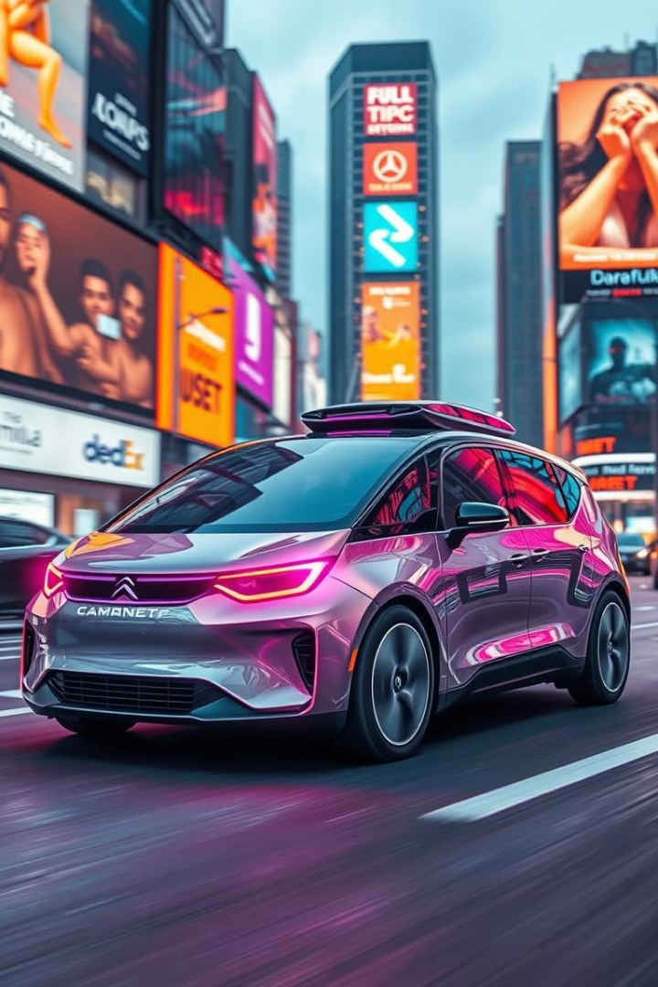



Applications: Unleashing the Potential
Robotics
RL agents can learn to control complex robotic systems for tasks like navigation, manipulation, and perception.
Game AI
RL enables the development of intelligent, adaptive game agents that can learn and adapt to player behavior.
Industrial Optimization
RL can be used to optimize manufacturing processes, logistics, and resource allocation in industrial settings.

Slide 10

Conclusion: The Road Ahead
1
Continuous Advancements
Ongoing research and development will drive further breakthroughs in reinforcement learning algorithms and applications.
2
Real-World Deployments
As the technology matures, we'll see more widespread adoption of RL in diverse industries and domains.
3
Ethical Considerations
Responsible development and deployment of RL systems will be crucial to ensure their safe and ethical use.

Slide 11
References
Reinforcement Learning: An Introduction by Sutton, R. S. & Barto, A. G. (2018).
Human-level control through deep reinforcement learning by Mnih, V., Kavukcuoglu, K. Silver, D.Rusu, A. A. Veness,
J., Bellemare, M. G & Petersen, S. (2015).
Proximal policy optimization algorithms by Schulman, J. Wolski, F. Dhariwal, P. Radford, A. & Klimov, O. (2017).

